Slide 1
Unit - II 2.5 Super Mesh and Star –Delta Transformation
Dr.Santhosh.T.K.

Slide 2
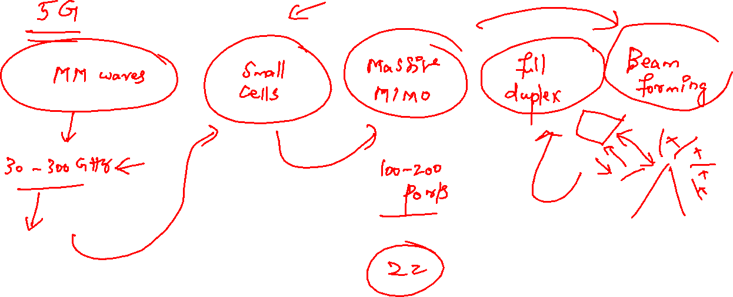
https://spectrum.ieee.org/everything-you-need-to-know-about-5g

Slide 3
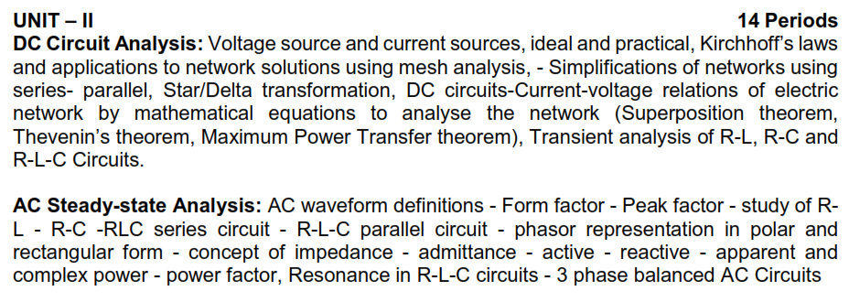
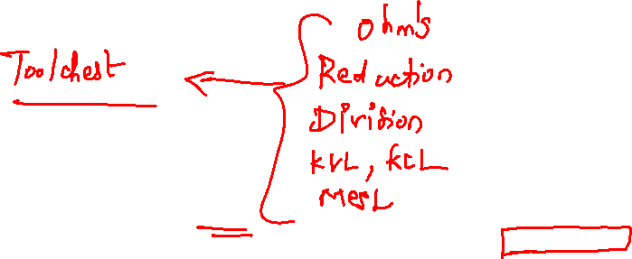
Syllabus

Slide 4
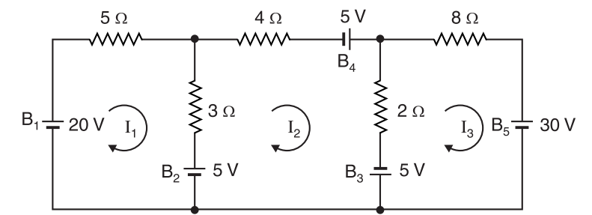
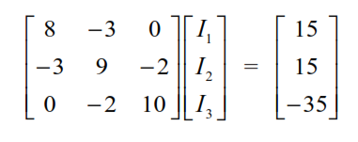
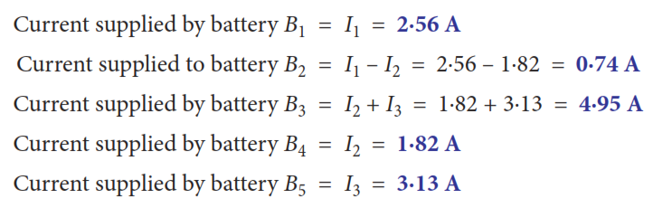
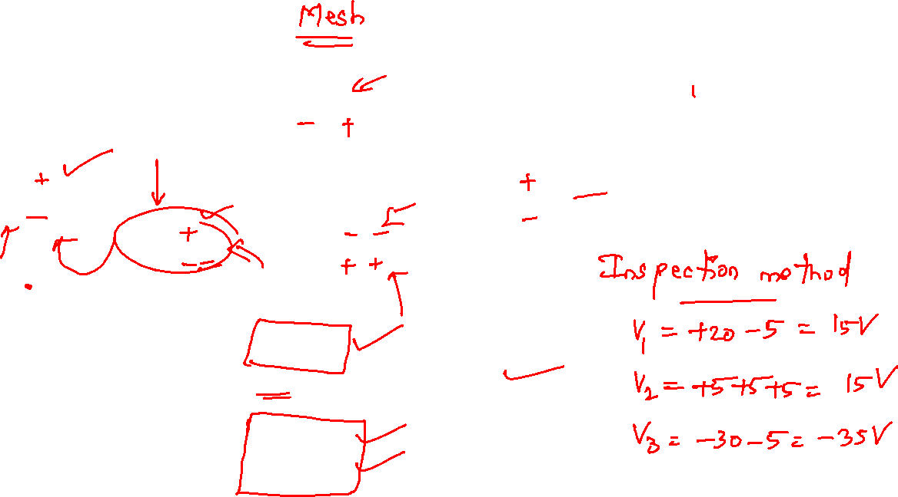

Slide 5
Another Example
2kΩ
2mA
1kΩ
+
–
12V
2kΩ
4mA
I₀

Slide 6
1. Identify Meshes
2kΩ
Mesh 3
2mA
1kΩ
+
–
Mesh 1
2kΩ
Mesh 2
12V
4mA
I₀

Slide 7
2. Assign Mesh Currents
2kΩ
2mA
I₃
1kΩ
+
–
2kΩ
12V
I₁
I₂
4mA
I₀

Slide 8
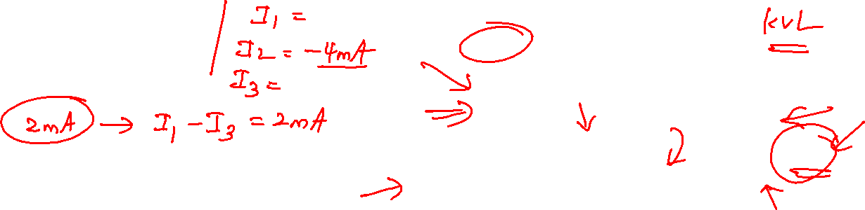
Current Sources
The current sources in this circuit will have whatever voltage is necessary to make the current correct
We can’t use KVL around any mesh because we don’t know the voltage for the current sources
What to do?
2kΩ
2mA
I₃
1kΩ
+
–
2kΩ
12V
I₁
I₂
4mA
I₀

Slide 9
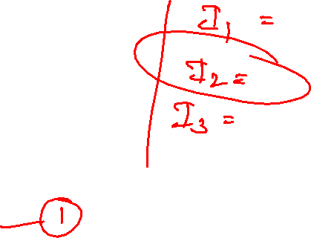
Current Sources
The 4mA current source sets I₂:
I₂ = –4 mA
The 2mA current source sets a constraint on I₁ and I₃:
I₁ – I₃ = 2 mA
We have two equations and three unknowns. Where is the third equation?

Slide 10
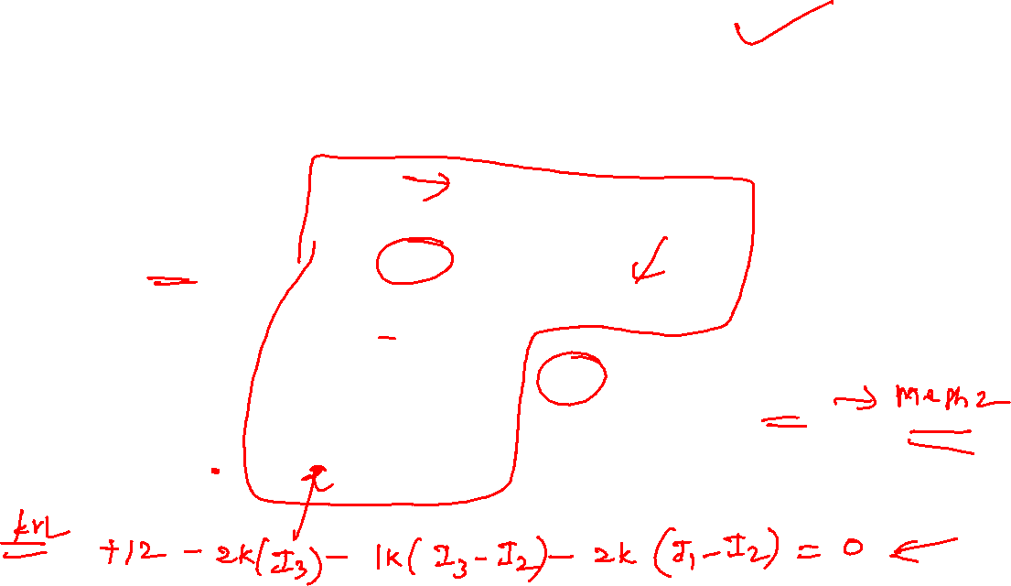
The Supermesh!
The Supermesh does not include this source!
2kΩ
The Supermesh surrounds this source!
2mA
I₃
1kΩ
+
–
2kΩ
12V
I₁
I₂
4mA
I₀

Slide 11
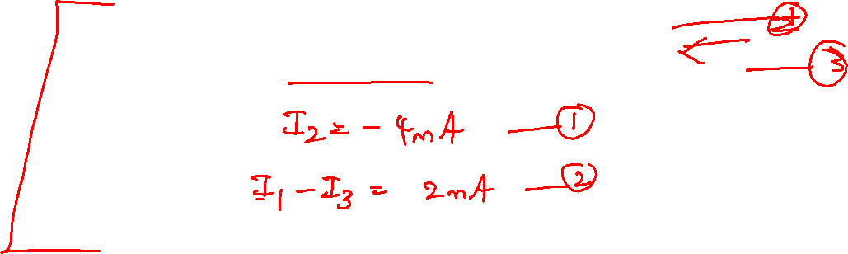
3. KVL Around the Supermesh
-12V + I₃ 2kΩ + (I₃ - I₂)1kΩ + (I₁ - I₂)2kΩ = 0
I₃ 2kΩ + (I₃ - I₂)1kΩ + (I₁ - I₂)2kΩ = 12V

Slide 12

Matrix Notation
The three equations can be combined into a single matrix/vector equation

Slide 13
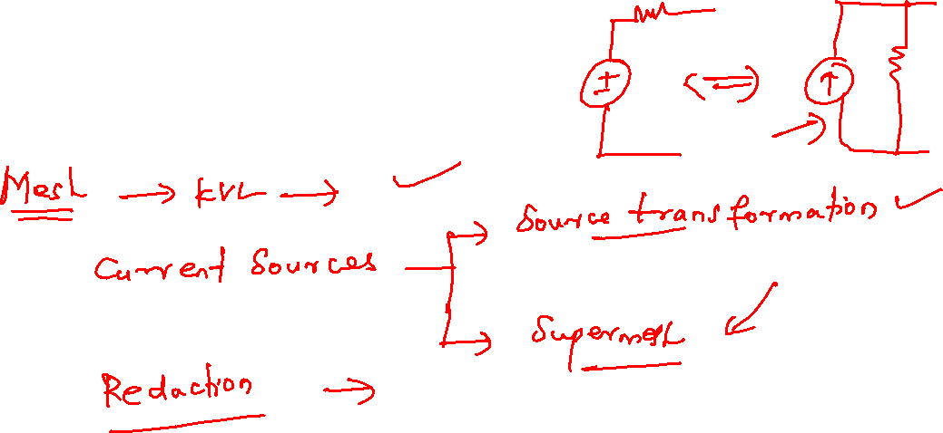
Solution
I₁ = 1.2 mA
I₂ = – 4 mA
I₃ = – 0.8 mA
I₀ = I₁ – I₂ = 5.2 mA

Slide 14
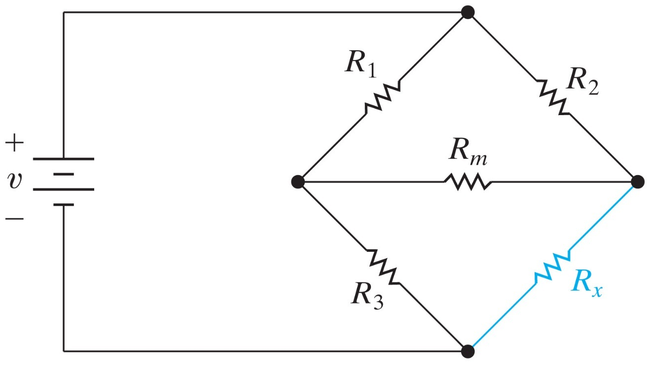
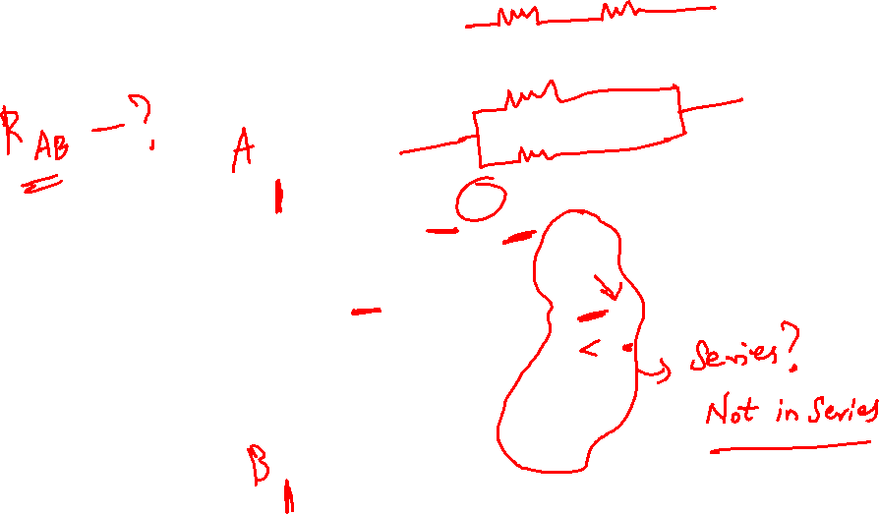
Back to the Bridge
Which resistors are in series?
Which resistors are in parallel?

Slide 15

Delta (Δ) Connection
Resistors R₁, R₂, and R_{m} (or R₃, R_{m}, and R_{x}) are in a Delta (Δ), or pi (π) connection.

Slide 16
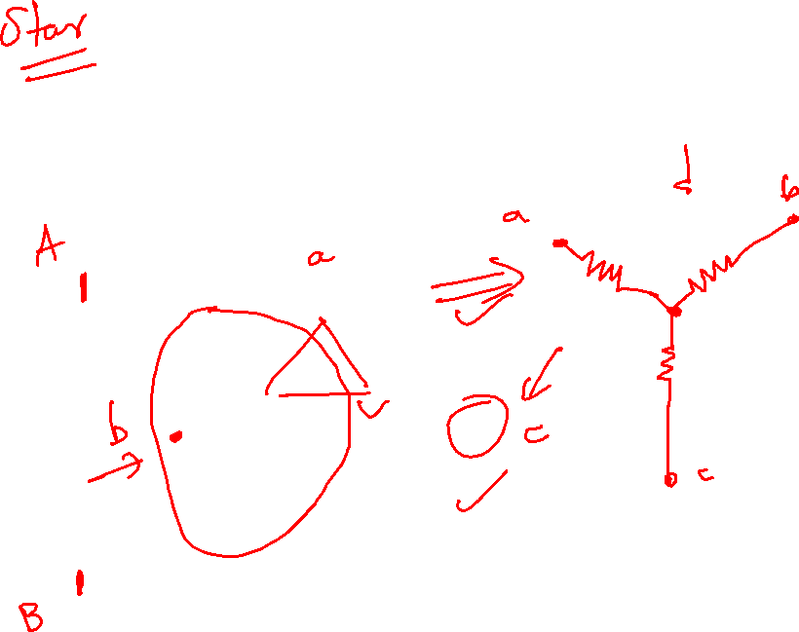
Wye (Y) Connection
Resistors R₁, R_{m}, and R₃ (or R₂, R_{m}, and R_{x}) are in a wye (Y), or tee (T) connection.

Slide 17
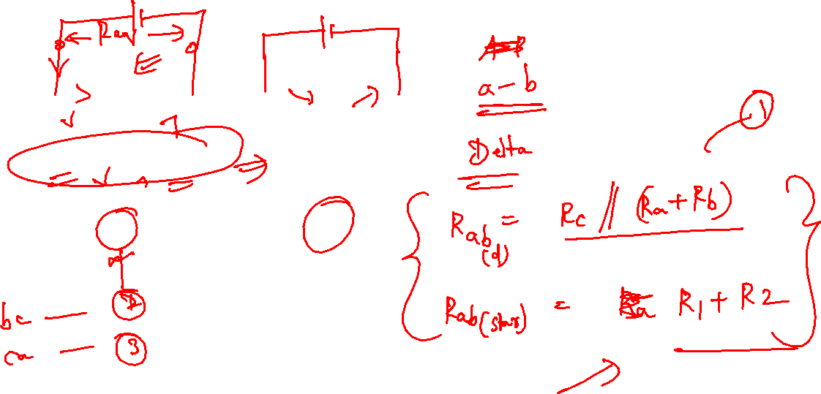
Δ – Y Conversion

Slide 18
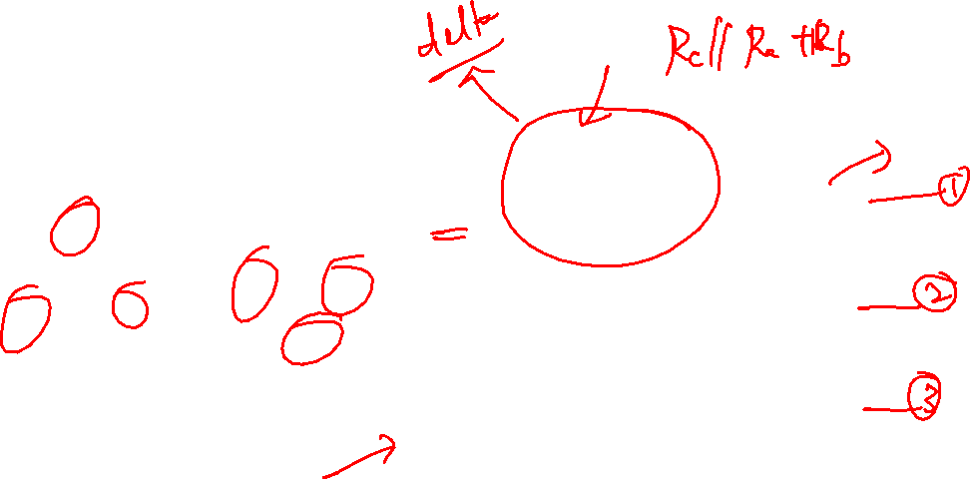
Δ – Y Conversion (continued)
The resistance between the terminal pairs must be the same for both circuits

Slide 19

Δ – Y Conversion (continued)
After some algebraic manipulation

Slide 20
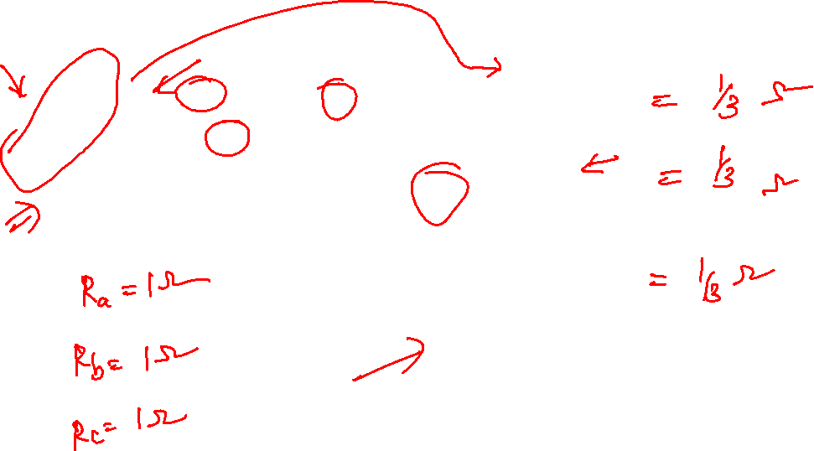

Slide 21
Y – Δ Conversion

Slide 22

Y – Δ Conversion (continued)
The resistance between the terminal pairs must be the same for both circuits

Slide 23

Y – Δ Conversion (continued)
After some algebraic manipulation

Slide 24
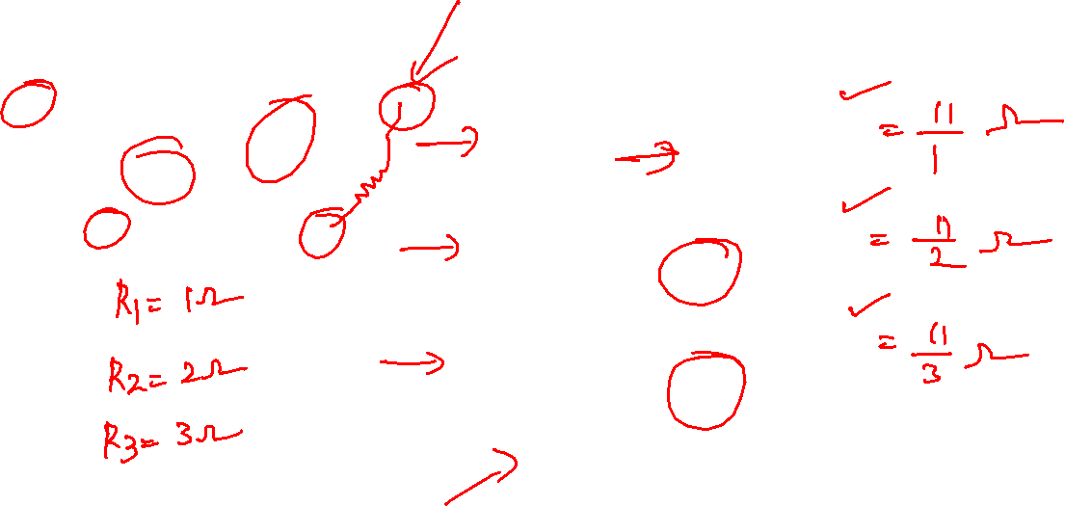

Slide 25
Nodal Analysis
Interested in finding the NODE VOLTAGES, which are taken as the variables to be determined
For simplicity we start with circuits containing only current sources

Slide 26
Nodal Analysis Steps
Select one of the n nodes as a reference node (that we define to be zero voltage, or ground). Assign voltages v₁, v₂, … v_{n-1} to the remaining n-1 nodes. These voltages are referenced with respect to the reference node.
Apply KCL to each of the n-1 non-reference nodes. Use Ohm’s law to express the branch currents in terms of the node voltages.
Solve the resulting simultaneous equations to obtain the node voltages v₁, v₂, … v_{n-1}.

Slide 27
Example
Select a reference node as ground. Assign voltages v₁, v₂, and v₃ to the remaining 3 nodes.

Slide 28
Example
Apply KCL to each of the 3 non-reference nodes (sum of currents leaving node is zero).
Node 1:
Node 2:
Node 3:

Slide 29
Example
Now express i₁, i₂, …i₅ in terms of v₁, v₂, v₃ (the node voltages). Note that current flows from a higher to a lower potential.

Slide 30
Node 1:
Node 2:
Node 3:

Slide 31
Writing the Nodal Equations by Inspection
The matrix G is symmetric, g_{kj} = g_{jk} and all of the off-diagonal terms are negative or zero.
The g_{kk} terms are the sum of all conductances connected to node k.
The g_{kj} terms are the negative sum of the conductances connected to BOTH node k and node j.
The i_{k} (the k^{th} component of the vector i) = the algebraic sum of the independent currents connected to node k, with currents entering the node taken as positive.

Slide 32
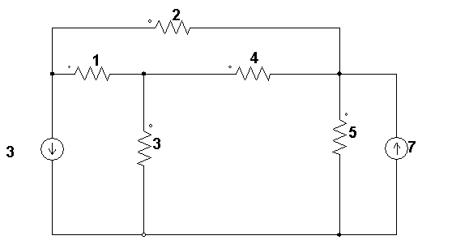
Practice Problem
Find all node voltages
Find the power supplied by the sources

Slide 33
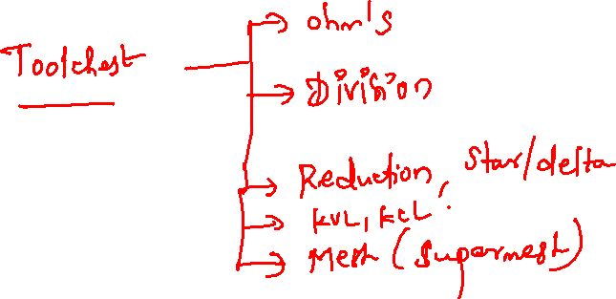
Summary

